Slide 1
OPERATING SYSTEM
CONTENTS

Slide 2
OPERATING SYSTEM
OPERATING SYSTEM: An operating system is a program that controls the entire operation of a computer system.
All input/output operations are channeled through the operating system.

Slide 3
EXAMPLE OF OPERATING SYSTEM
UNIX ( for minicomputer)
MS-DOS( for microcomputer)
LINUX

Slide 4
MAJOR FACILITIES PROVIDED BY OPERATING SYSTEM
Starting computer operation automatically when power is turned on.
Controlling input and output.
Controlling program execution.
Managing use of various levels of memory namely, main memory and disk.
Providing security to user’s jobs and files.

Slide 5
KEY POINTS
The most important program that runs on a computer.
Every general-purpose computer must have an operating system to run other programs.
Operating systems perform basic tasks, such as recognizing input from the keyboard, sending output to the display screen, and controlling peripheral devices such as disk drives and printers.

Slide 6
SOFTWARE AND HARDWARE
SOFTWARE:
Software is a set of instructions that makes the computer perform task.
In other words, software tells the computer what to do.
HARDWARE:
The electronic circuits used in building a computer that executes the software is known as hardware.
In other words the physical device that make up the computer are called hardware.

Slide 7
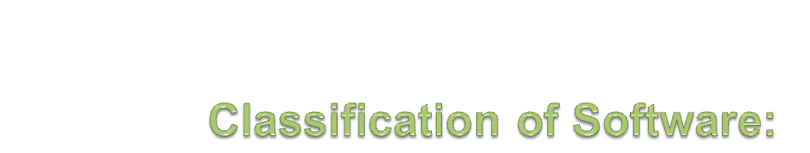
There are many types of software and it is difficult to classify all types of software completely ,some of them are:
    System Software
    Application software
    Engineering and Scientific software
    Real time software
    Personal computer software
    Business software

Slide 8
Application software: Application software is the set of programs necessary to carry out operations for a specified application.
For example, Programs to solve a set of equations, process examinations results etc.
System software: System programs are general programs written for the system which provide the environment to facilitate the writing of application software.

